Slide 1
Text Mining 2:
Sentiment
Brock Tibert
btibert@bu.edu

Slide 2
Outline
Sentiment Analysis landscape
Hands on in python
Another example of how ML applications still apply

Slide 3
Let’s set the landscape again

Slide 4
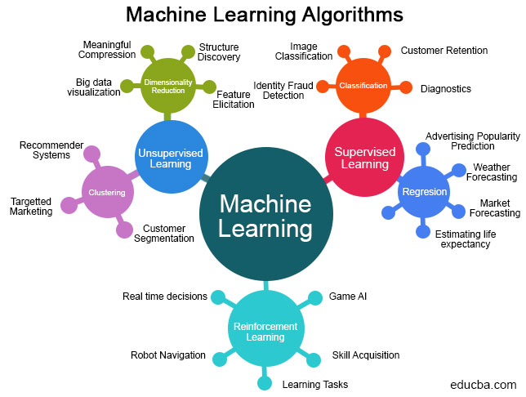

Slide 5
Sentiment Analysis

Slide 6
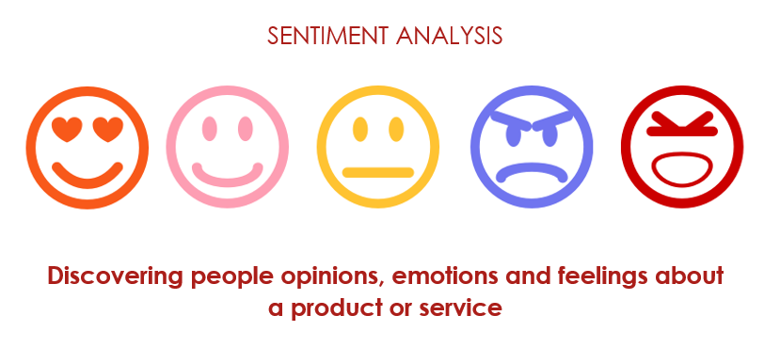

Slide 7
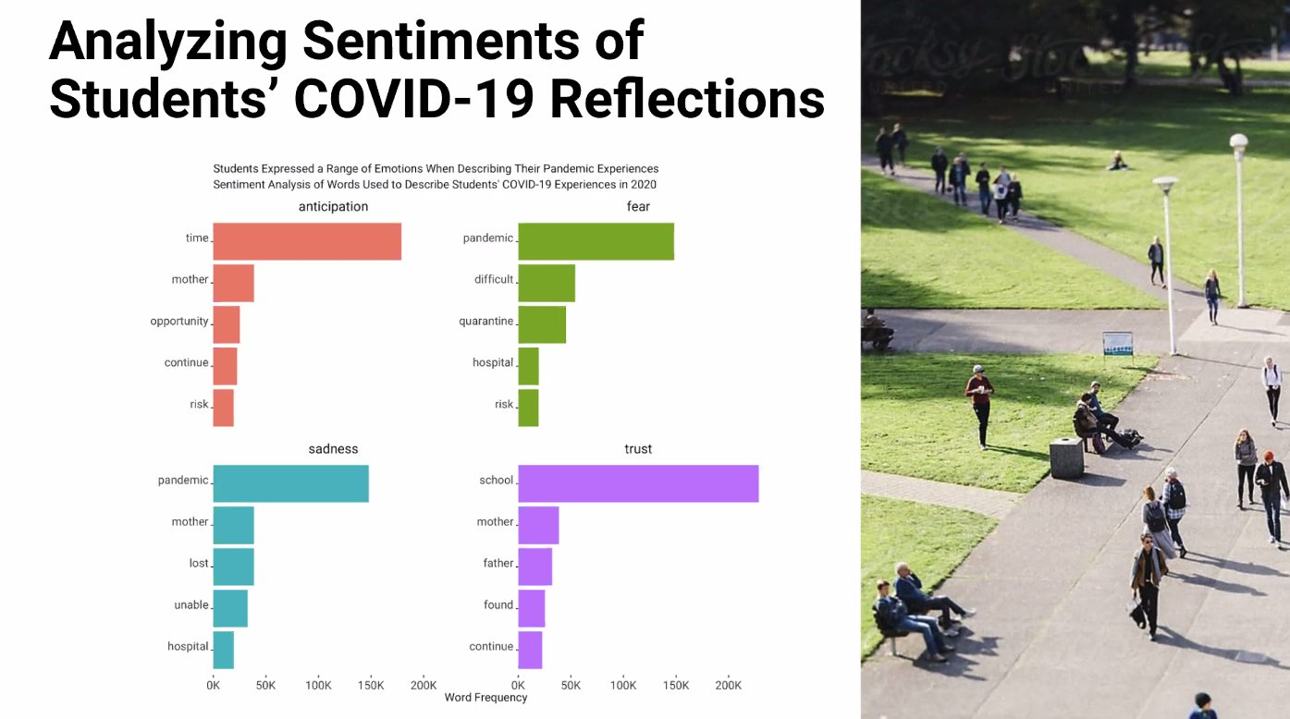
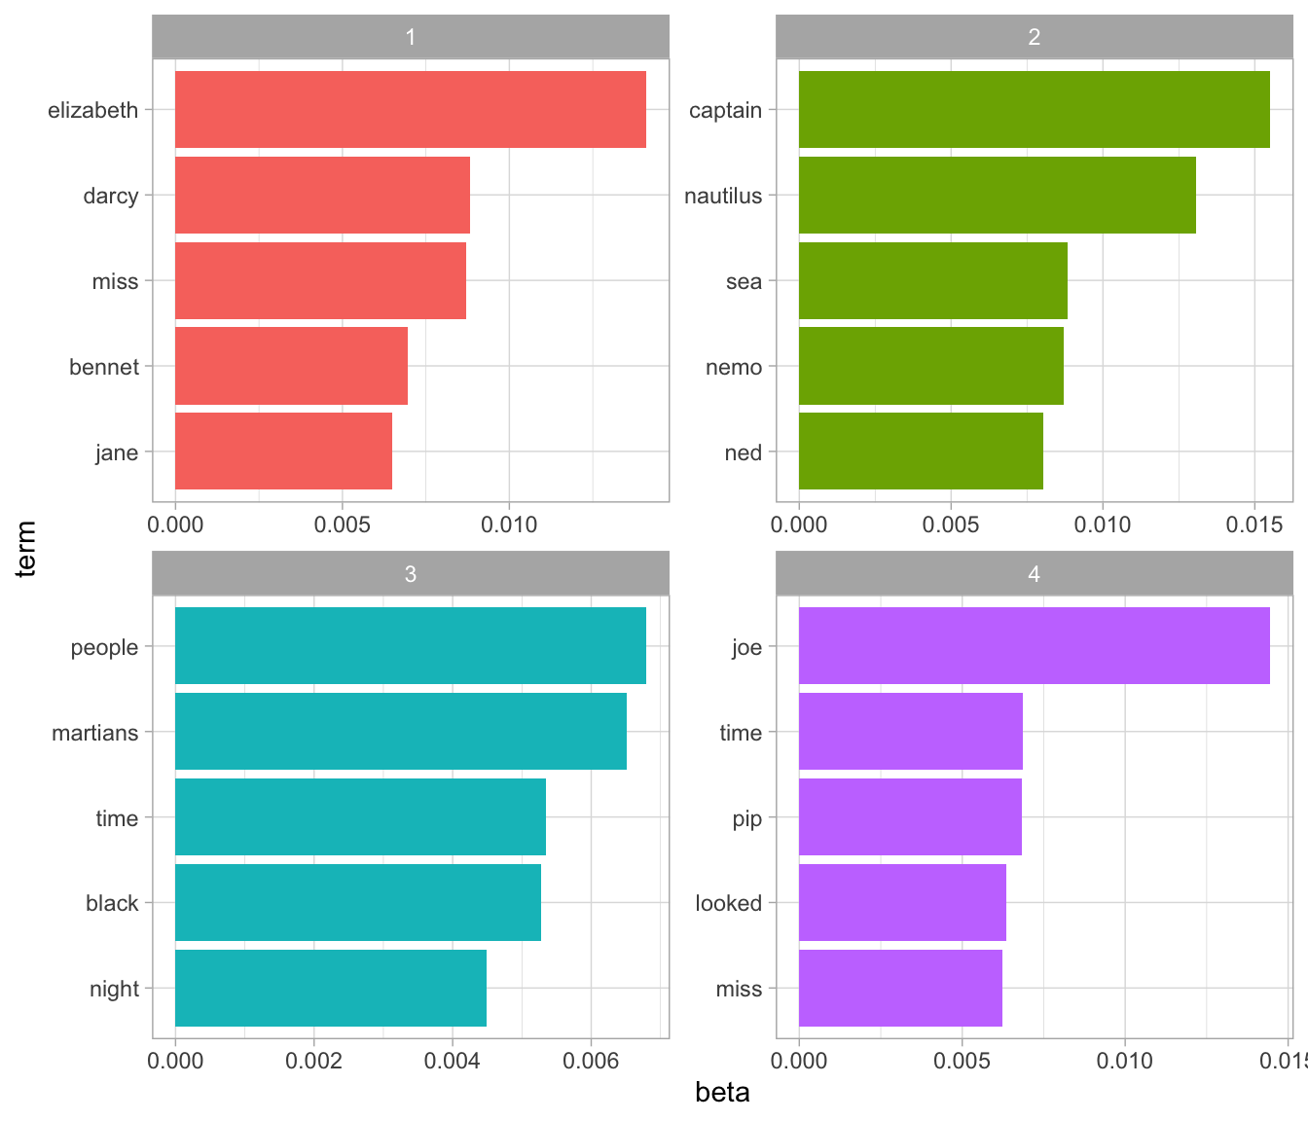
This just happened! Why copy/paste code is bad
Notes:
SOURCE: https://twitter.com/CarnegieDartlet/status/1365036097844240387
Right hand side = https://www.tidytextmining.com/topicmodeling.html
Point = don’t copy/paste blindly! Right hand side is slightly different in showing beta, or estimated per word/topic probabilities, but clearly just cleaning up some rstats code

Slide 8
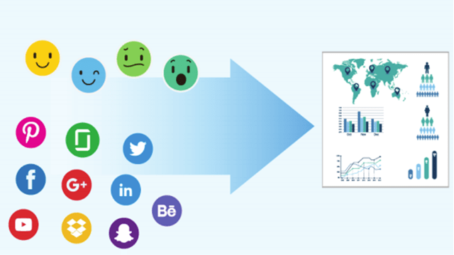
Ultimately, what are we trying to do?

Slide 9
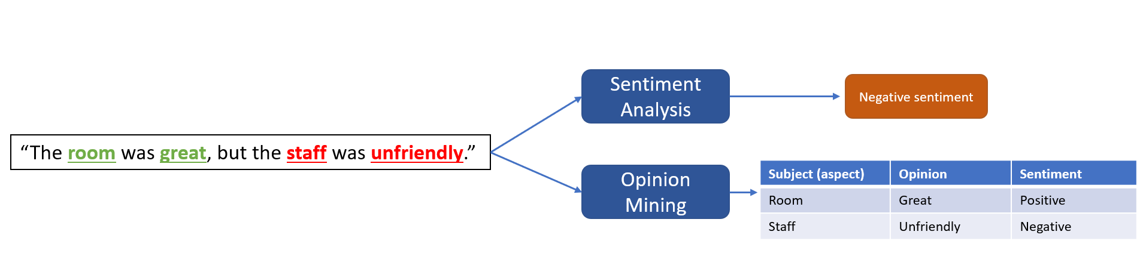
An example of breaking down text

Slide 10
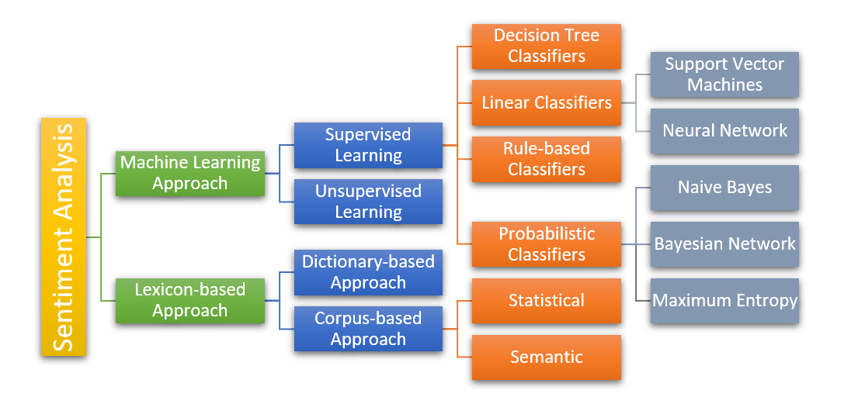
Various approaches
Notes:
https://devopedia.org/images/article/105/8215.1532752754.png

Slide 11
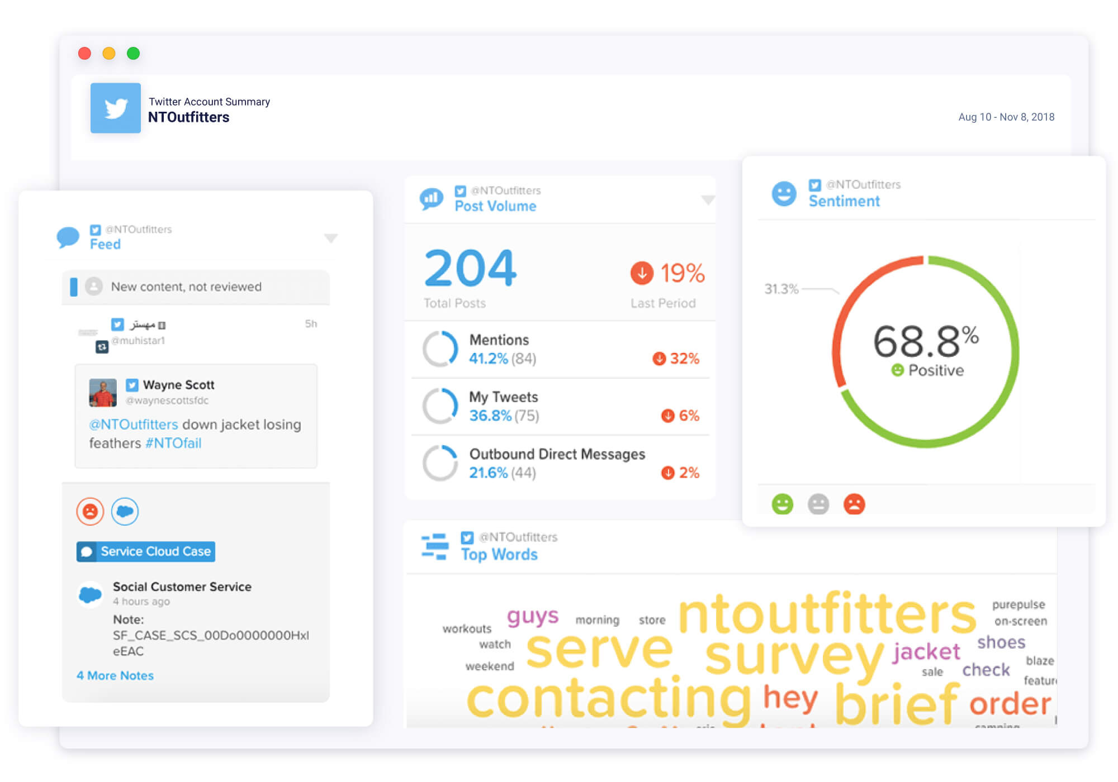
$$$$ Software (Just one example)
Notes:
Social Studio/Radian 6 via Salesforce
https://vrpconsulting.com/wp-content/uploads/2020/05/%D0%BC%D0%BE%D0%BA%D0%B0%D0%BF-Social-Media.jpg

Slide 12
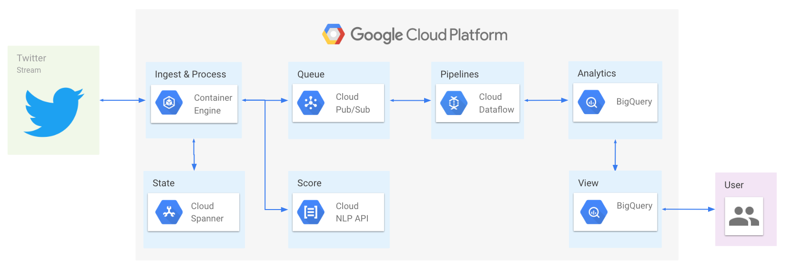
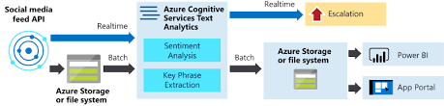
Cloud Services/Tools/API (just two below)

Slide 13

Text Analytics:
Sentiment

